Slide 1
Market Basket Analysis
Karthika Selvaraj
Aishwarya Saibewar
Pooja Bhatia

Slide 2
Introduction
If you’ve ever gone onto an online retailer’s website, you’ve probably seen a recommendation on a product’s page phrased as “Customers who bought this item also bought” or “Customers buy these together”.
An unsupervised analysis called market basket analysis is a set of affinity calculations meant to determine which items sell together. For example, a grocery store may use market basket analysis to determine that consumers typically buy both hot dogs and hot dog buns together.
In the real world, Beer – Diaper combination serves as best example which will never strike without doing this analysis.
Notes:
Work on font size

Slide 3
Problem Statement
In the retail world, a shopkeeper is always exploring the buying patterns of customers. The most common questions that come in mind are:
What is the most sold product B whenever product A is sold?
What is the opportunity of cross sell by encouraging customers to purchase products addition to the original items.
What are the combinations of products frequently bought together.
How can we enhance sales by recommendation of products.
How can we maximize our profit by correct placement of items.
We are trying to answer these question here via our analysis.
Notes:
Explain cross sell

Slide 4
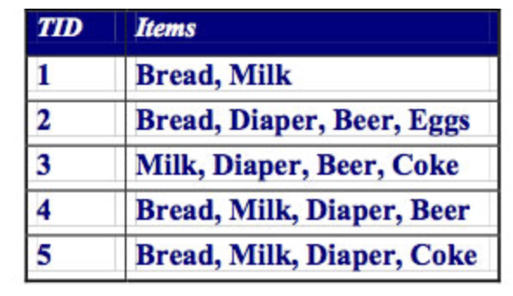
Analytic approach
Our Analysis is dependent on certain parameters.
First Parameter is Support
Support refers to the probability of items occurring in the dataset.
Value of Support help in determining the minimum transactions needed to identify Itemset for the analysis.
Support for Bread and Milk :
3/5
Notes:
Split the slide and introduce each component one by one
Component by probability

Slide 5
Analytic approach
Second Parameter is Confidence.
Confidence refers to conditional probability of buying product Y when is X is bought.
Confidence of buying Milk when bread is bought : 3/4
Notes:
Split the slide and introduce each component one by one
Component by probability

Slide 6
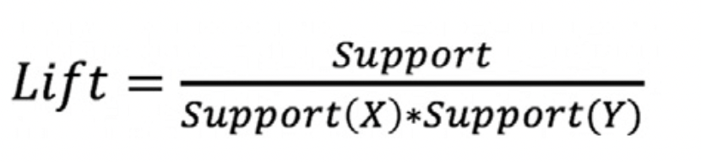
Analytic approach
Sometime Confidence can be misleading; therefore, we consider our third parameter, Lift.
Lift refers to the strength of association between the products on the left and right hand side of the rule.
The larger the lift the greater the link between the two products.
Lift for Bread and Milk : 3/5 = 15/16
4/5 *4/5
Notes:
Split the slide and introduce each component one by one
Component by probability

Slide 7
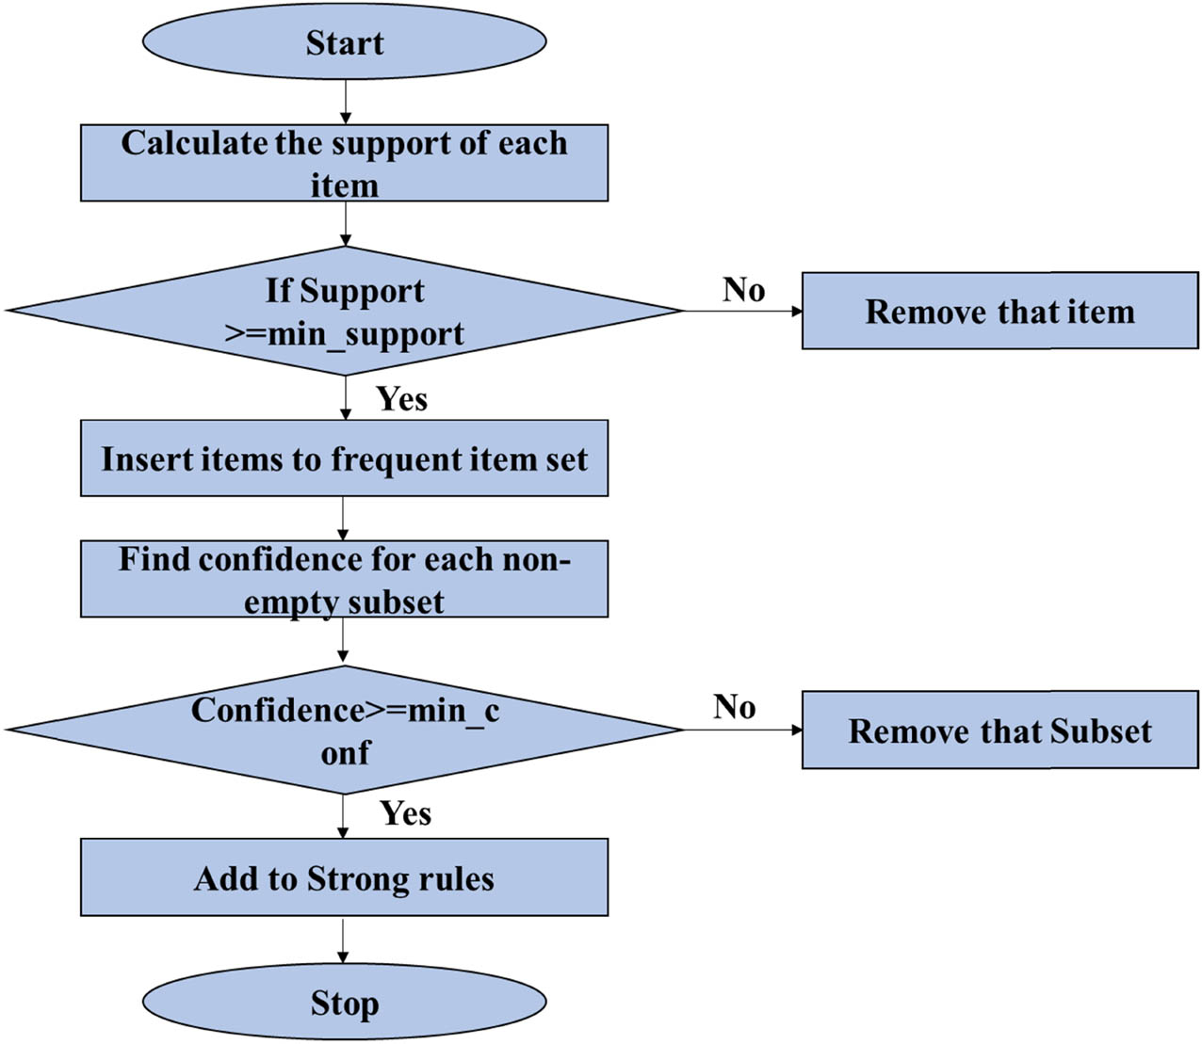
Analytic approach
We are using Apriori Algorithm to find the frequent item sets.
Algorithm runs for all the possible combination starting from 2 item until a specified number.
Once we have found itemsets using appropriate support and confidence, it will filter the dataset using lift value to give the result.
Notes:
Split the slide and introduce each component one by one
Component by probability

Slide 8
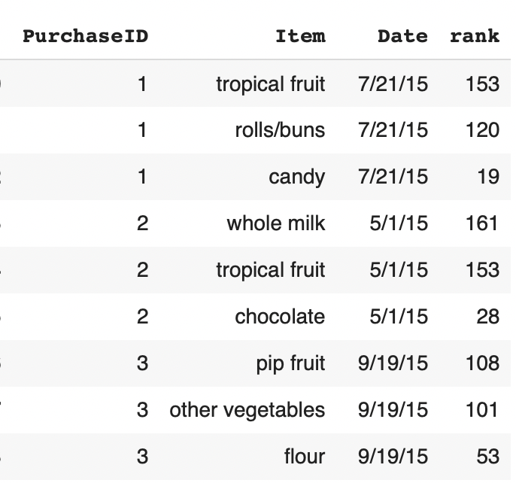
Data collection and processing
We have collected transaction data from grocery store(in our case, we took it from data world).
We need to create a list of transaction containing items as a sub-list.
Input Columns list :
Purchase ID
Item
Date
Rank column is created as per Rank of each item.
Raw Data
Notes:
Explain the changes made

Slide 9
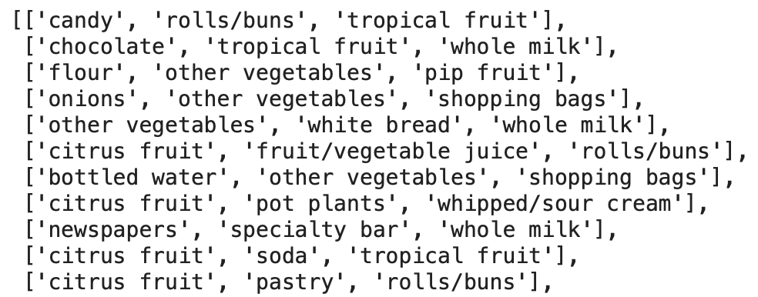
Data collection and processing
The dataset with rank is then pivoted to show all items from a purchase in single row.
All the columns are concatenated into a single column(final) and then blanks are removed.
All the values in final column are converted to a list.
Final column is then converted into a final list with values as sub list.
Final list
Notes:
Explain the changes made

Slide 10
Data collection and processing
We have used Apriori function from Apyori Library to give us frequent item set and their respective Support, Confidence and Lift values
This function will by default take 0 as minimum values from Support, Confidence and Lift.
We can set minimum value for these, here we have taken 0.05% for support, 5% for confidence and 3 for lift.
We can also limit the value of items in an itemset. We have taken maximum number of items as 6.

Slide 11
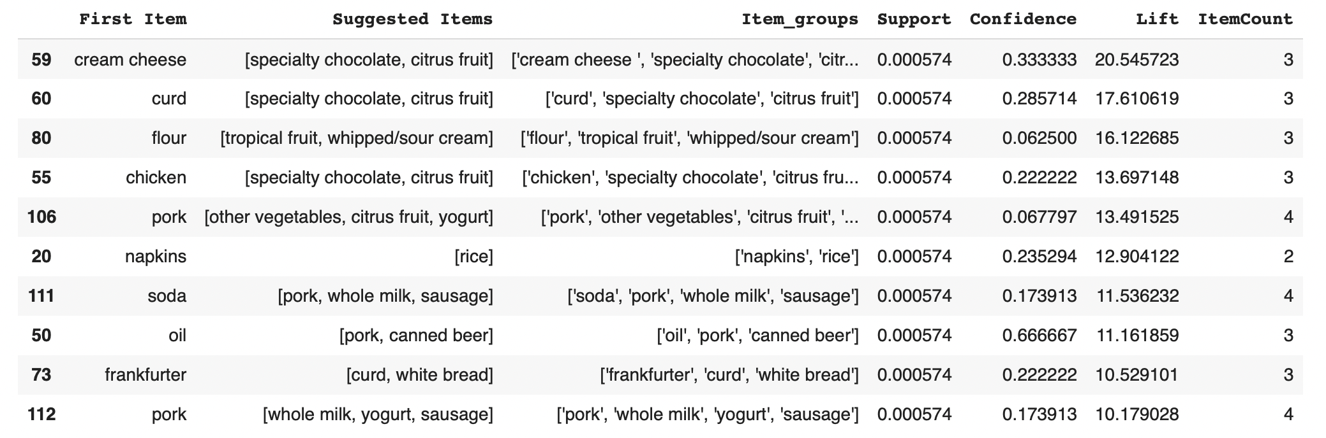
Model result and analysis
The result shows the recommended products that can be bought along with the first product.
It also provides the evidence with the support ,confidence and lift.
We can also limit the value of support, confidence and lift from the output table.
Notes:
Interpretation of numbers
Add another slide : takeaway with top values, and what can be done (like placing them together)
Business insights

Slide 12
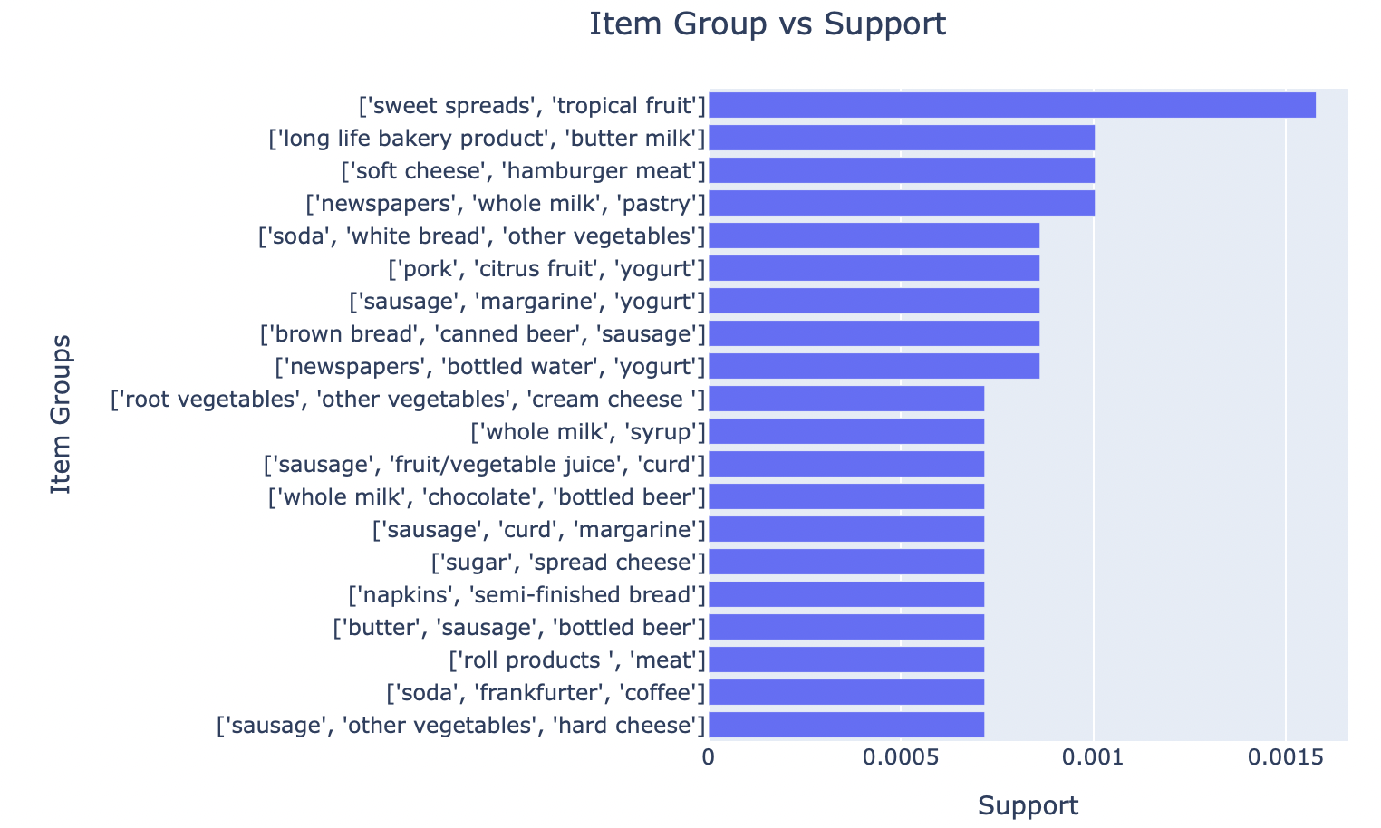
Model result and analysis
Top 20 Item-sets with highest support value
Highest support value is approx. 0.0016 which implies there are more than 30 transactions with sweet spread and tropical fruits.
8 combinations appeared in more than 15 transactions

Slide 13
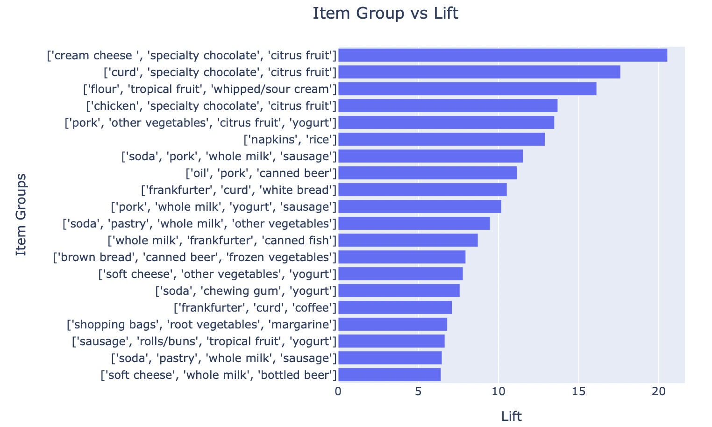
Model result and analysis
Top 20 Item-sets with highest lift value
In this case, the highest lift value is greater than 20 which implies that chance of picking cream cheese, specialty chocolate and citrus fruits together is more than items sold individually.
Items from the combination set should be placed together in an aisle for customer to access it.

Slide 14
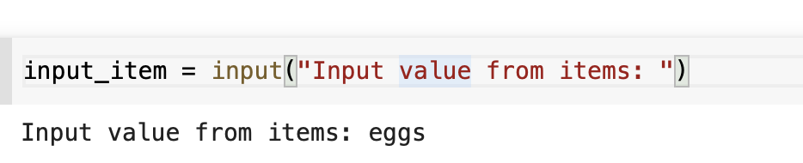
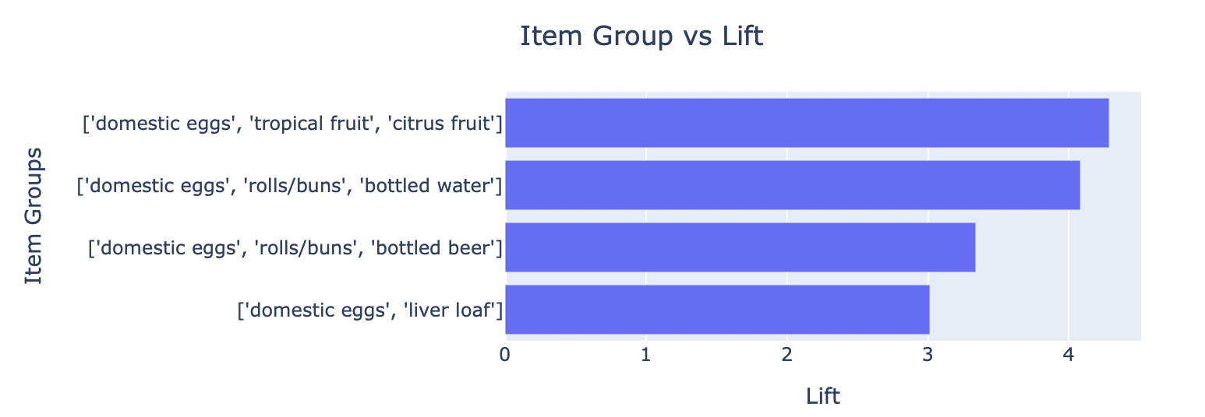
Model result and analysis
Analysis for a specific product, example : Eggs
When a person buy eggs, he is most likely to buy fruits or rolls/buns or bottled beer/ water.
Retailer can choose any combination from 4 to sell together at discounted price.
Lift is highest for tropical /citrus fruits if eggs are bought, therefore, fruits can be placed next to eggs.

Slide 15
Conclusions
Market Basket Analysis is an example of unsupervised learning.
Following the association rules, retailers can understand the underlying patterns in their sales.
We saw that several combinations having product which have no relation to each other but still appeared as top selling combination. For example : Napkins and rice
Here, we have used the data of a retail store, but any industry can benefit for better understanding of how their products move.

